Slide 1
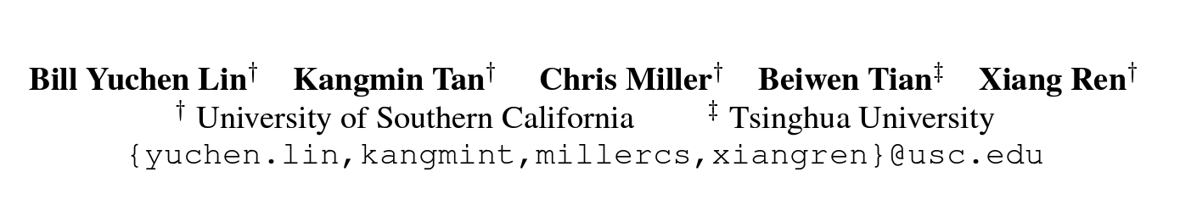



Unsupervised Cross-Task Generalization via Retrieval Augmentation
https://inklab.usc.edu/ReCross/
Notes:
Hi everyone, my name is Bill Yuchen Lin. I’m a final-year PhD student at USC, advised by Xiang. Kangmin is a master student at USC, Chris is an incoming PhD student of our lab and Beiwen was a summer intern from Tsinghua university. We are going to introduce our work on unsupervised cross-task generalization via retrieval augmentation!

Slide 2



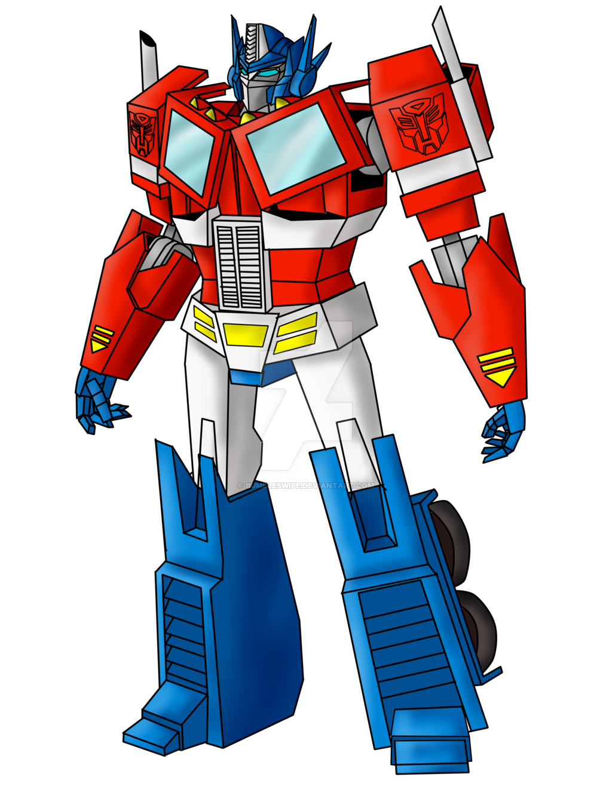






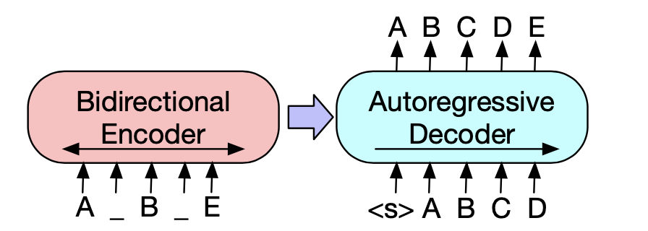
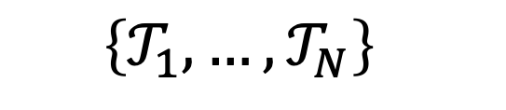
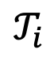
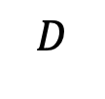
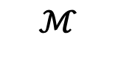
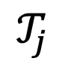
Massively Multi-Task NLP Models
Upstream
Training
Input:
Output:
upstream tasks
Is this review positive or negative? Review: Best cast ...
$$D$$
Positive
: amazon_plority
$$𝒯_{i}$$
Input:
Output:
Make a title for news: British mathematician Stephen Haw...
$$ℳ$$
Mathematician Hawking ...
$$\left\{𝒯_{1}, …,𝒯_{N}\right\}$$
Multi-Task
NLP Model
$$𝒯_{j}$$
: gigawords
Notes:
Recent studies show that it’s promising to train a massively multi-task NLP model based on Transformer lang models.
The general recipe for training such a model is to first create a mixture dataset of various diverse upstream tasks which shares the unified seq2seq format. For example, this upstream task T_i is a sentiment analysis task and the task Tj is a summarization task. And both of them now are in the seq2seq format. We use this combined data to fine-tune a pre-trained seq2seq LM such BART and T5, so that the trained model can be very powerful in all these upstream tasks.

Slide 3
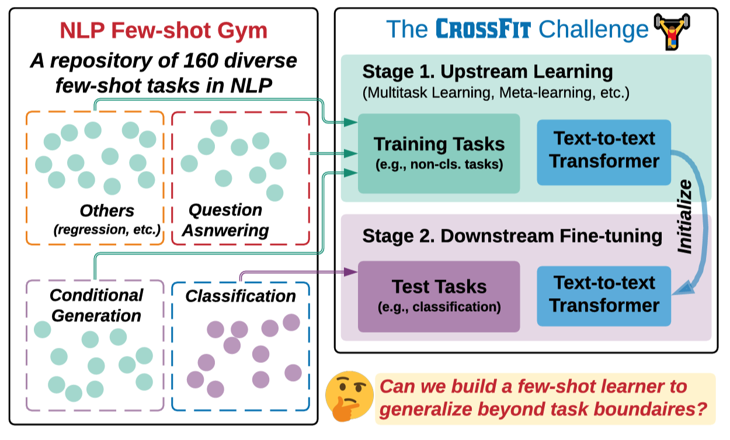

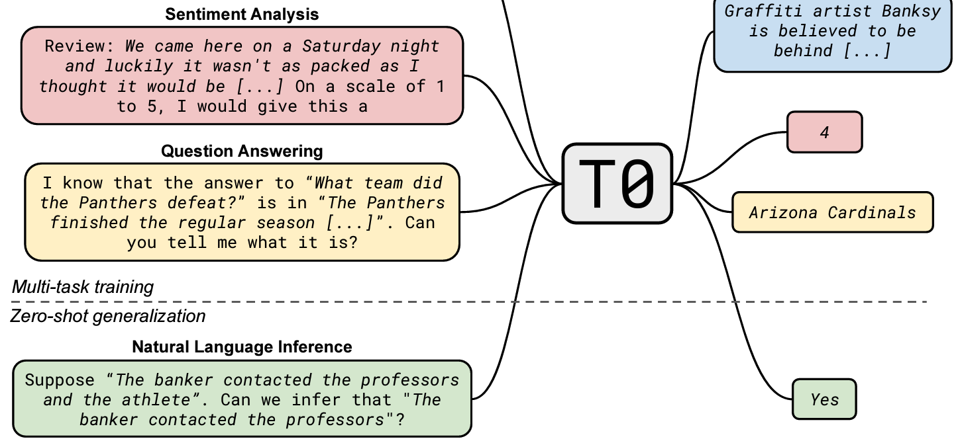
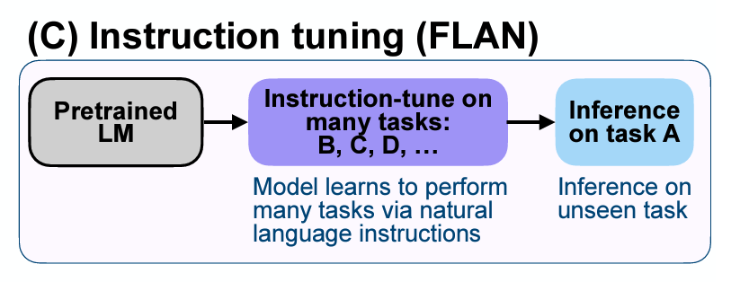

CrossFit (Ye et al. 2021)
upstream tasks
Multi-Task
NLP Model
T0 (Sanh et al. 2022)
FLAN (Wei et al. 2022)
Notes:
Beyond multi-tasking, a particular benefit of such massive multi-task NLP model is the cross-task generalization ablity. Let’s look at some concrete examples. The CrossFit framework fine-tunes a BART model on 160 diverse NLP tasks and then when we have a new unseen task, we can use only a few annotated examples for fine-tuning the upstream model in order to generalize to this new task. So this is a few-shot learning setup, and we have to assume that the human annotations are necessary for generalization. Therefore, its applications would be very limited.
Later, a google team proposed FLAN and a huggingface-based team proposed T0. Both of them use natural language templates to unify the data of upstream tasks such that the produced multi-task model is more promising in zero-shot task generalization. In our paper, we focus on improving such generalization ability of models like T0.

Slide 4


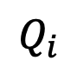
Unsupervised Cross-Task Generalization
upstream tasks
Multi-Task
NLP Model
I want to ski!
$𝓤_{i}$: an unseen task w/ a few unlabeled data
Input:
Fred is ... He .... In the sentence, does the pronoun "he" refer to Fred? Yes, no?
Unsupervised
Cross-Task Generalization
Input:
Does "her" refer to Alice or Mary in this sentence: Alice ... Mary... and her ...
$$Q_{i}$$
Notes:
Let’s formulate the problem of unsupervised cross-task generalization here.
Given such a multi-task NLP model, we want to make this model to perform a new task which is never seen before.
We consider the situation where we know a few unlabeled examples which we call the query examples.
So for this unseen task U_i here, we have a set of unlabeled query examples Q_i.
For these examples, we only have the input texts of them but not the outputs at all. Therefore, it’s also a zero-shot setting for task generalization, yet it’s more general in terms of the number of the unlabeled data for the target task.

Slide 5
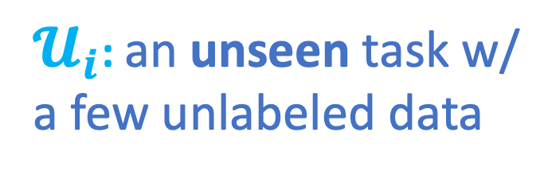
Retrieval Augmentation
$𝓤_{i}$: an unseen task w/ a few unlabeled data
upstream tasks
Retrieve some additional data
for “re-learning” relevant skills.
Notes:
And in this paper, we want to focus on how to augment a multi-task model by using these query examples to retrieve some additional data that share relevant skills for re-learning to generalize across tasks.
From this motivating example in this figure, we can see these two retrieved tasks are the most relevant skills to this unseen task.

Slide 6
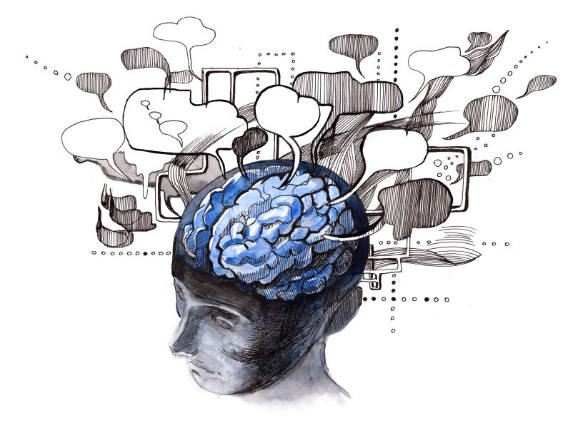

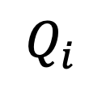
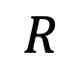


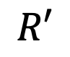
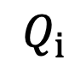
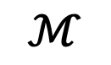
$𝓤_{i}$: an unseen task w/ a few unlabeled data
Input:
Fred is ... He .... In the sentence, does the pronoun "he" refer to Fred? Yes, no?
Unsupervised
Cross-Task Generalization
Input:
Does "her" refer to Alice or Mary in this sentence: Alice ... Mary... and her ...
$$Q_{i}$$
The ReCross Framework
$$Q_{i}$$
$$R′$$
$$Q_{i}$$
$$ℳ$$
$$R$$
Encoders
topK
MIPS
Reranker
Dense
Index
$$𝓤_{i}$$
Notes:
In order to benefit from such retrieval augmentation, we propose a novel framework named ReCross.
ReCross has two ranking stages. In the first ranking stage, we use an encode to encode each query example and then query the initial candidates from the pre-computed dense index of all upstream data. This process is done by maximum inner product search which is extremely efficient.
Then given these initial canadines, we use a more powerful reranker module that takes each pair of query example and candidate example to further justify the suitability to use a certain candidate as the final result.
Finally, we take a sub set of the candidates that are ranked at the top for fine-tuning the upstream model to generalize towards the target task.

Slide 7
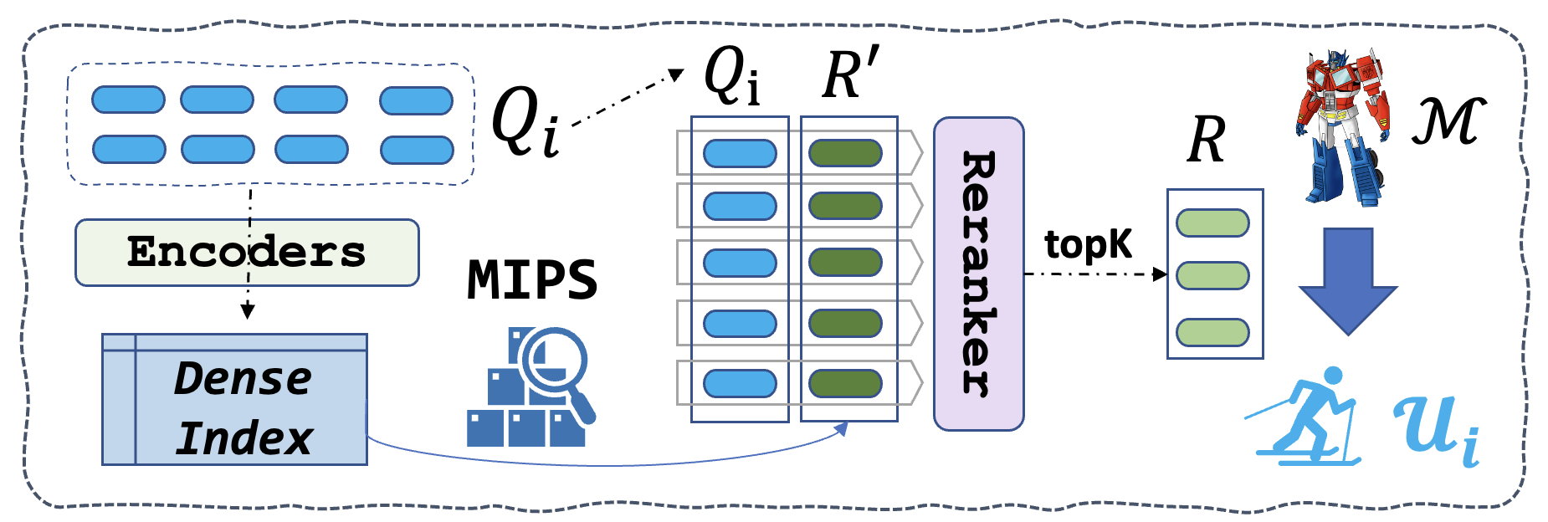
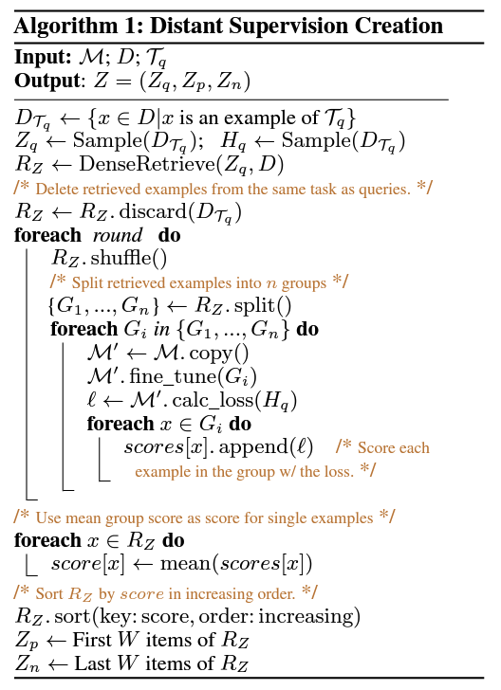


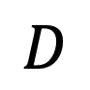
Decoders
hidden dim
pair-wise score
Reranker
#examples
Dense
Index
query
cand.
Encoders
upstream data
distant sup.
$$D$$
Make a title for news: British mathemat ...
Notes:
Specifically, to compute such a dense index, we reuse the encoder layers of the upstream model, which is a encoder-decoder architecture. We use the hidden states between encoder and decoders here to build the dense vector representations for all examples in the upstream data. These dense vectors then form a dense index that support MIPS query. We also propose an algorithm to generate distant supervision for training the reranker. The reranker here is a corss-attention encoder, and we use a Roberta-base in practice here. The main motivation of the proposed algorithm is to use the results from the dense retriever and run multiple rounds of virtual learning such that we can estimate the utility scores of the candidates by looking at their loss. We leave more detailed description in our paper.

Slide 8
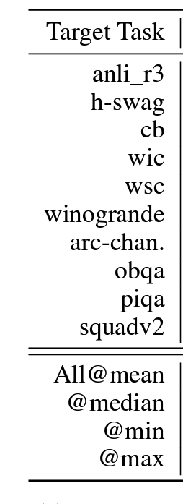
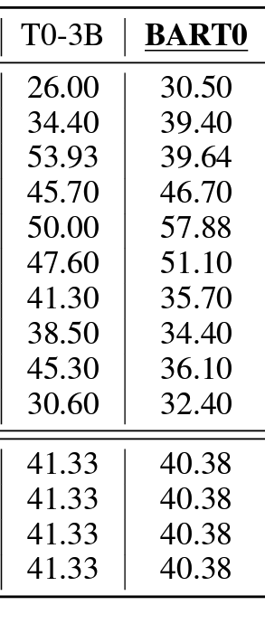
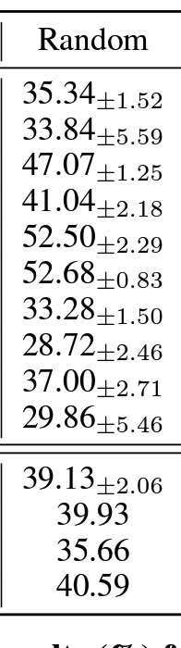
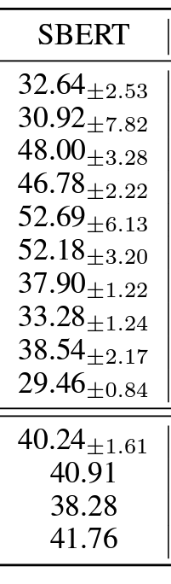
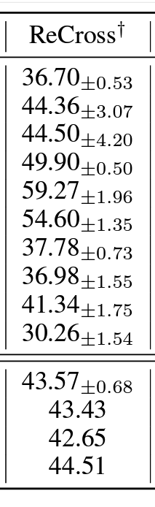
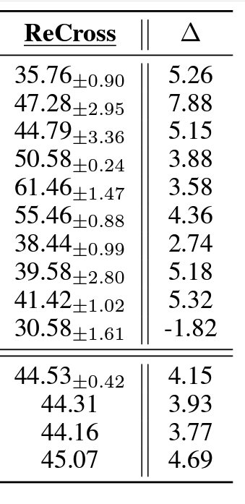
Evaluation
1/8 size
5 different query sets: Q
Notes:
For our evaluation, we choose 10 target tasks that are unseen in the upstream data, and we train our own BART0 as the base LM, which is comparable to T0 yet much smaller. Considering the computation cost for evaluating at scale, we use this BART0 as the base model. Then, the first baseline method is to use random retrieval. For this kind of retrieval augmentation methods, we run 5 times of experiments and each of them is with a different query set.
And we find that the overall performance is pretty similar to not using any retrieval. This is expected. And we also use SentenceBERT to build the index for retrieving, and we find that such semantic-based retrieval does not improve the performance too.
This is the result of our ReCross method without the reranker and we can see that the results are already much improved, meaning that the hidden states from BART0 are more powerful.
And our proposed reranker here further improved the results. On average and median, ReCross improved the base model by 4 points.

Slide 9
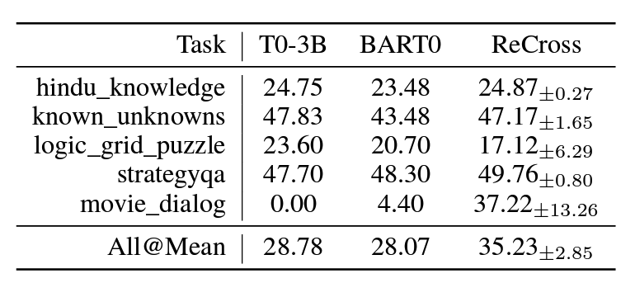
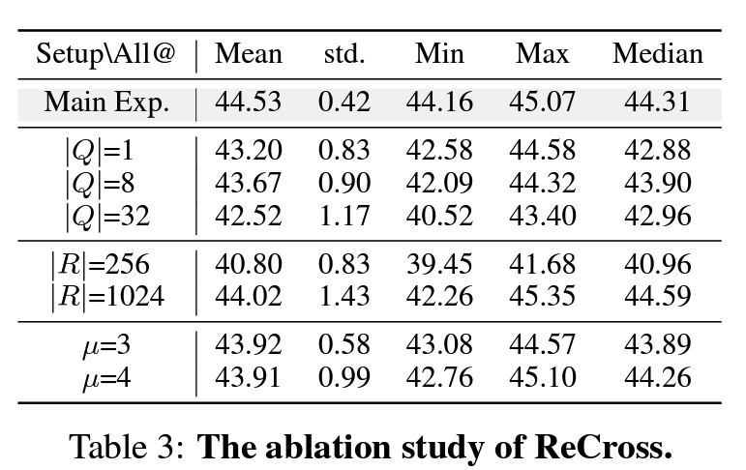
Analysis
Notes:
We also have more analysis and ablation in our paper. We compare the settings when using different sizes of the query sets and the retrieved data, as well as the upsampling ratio for reranking.

Slide 10
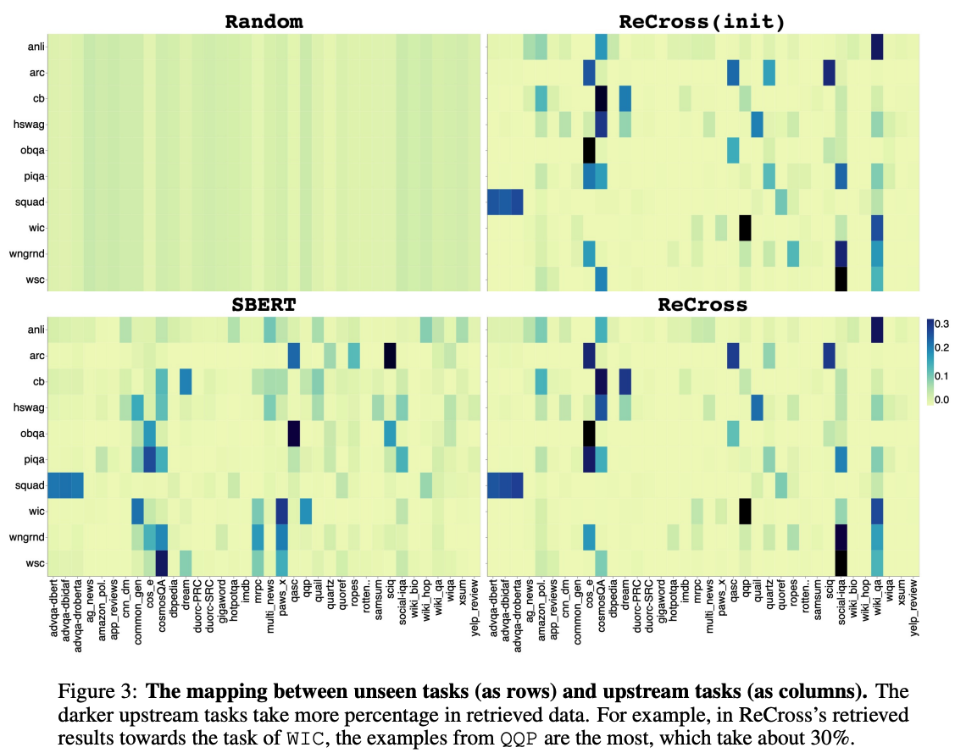
Notes:
To better understand the retrievers, we draw the heatmap to visualize the distribution of the retrieved data for each target task over the upstream tasks. We can see that the behavior between SBERT and ReCross is very different, and we think it is a very important future direction to get a deeper analysis on the task correlation and example utility.

Slide 11
Conclusion
ReCross: a retrieval augmentation method for unsupervised cross-task generalization.
Two ranking stages: simple & intuitive
Significant improvement.
Future directions
More rigorous task/example representation for indexing.
Parameter-efficient tuning for faster adaptation.
Methods to use unlabeled data for guiding re-learning.
….

